Slide 1
Features Description and Detection
Dr. Rongzhong Li
CSC391/691 Fall 2016

Slide 2
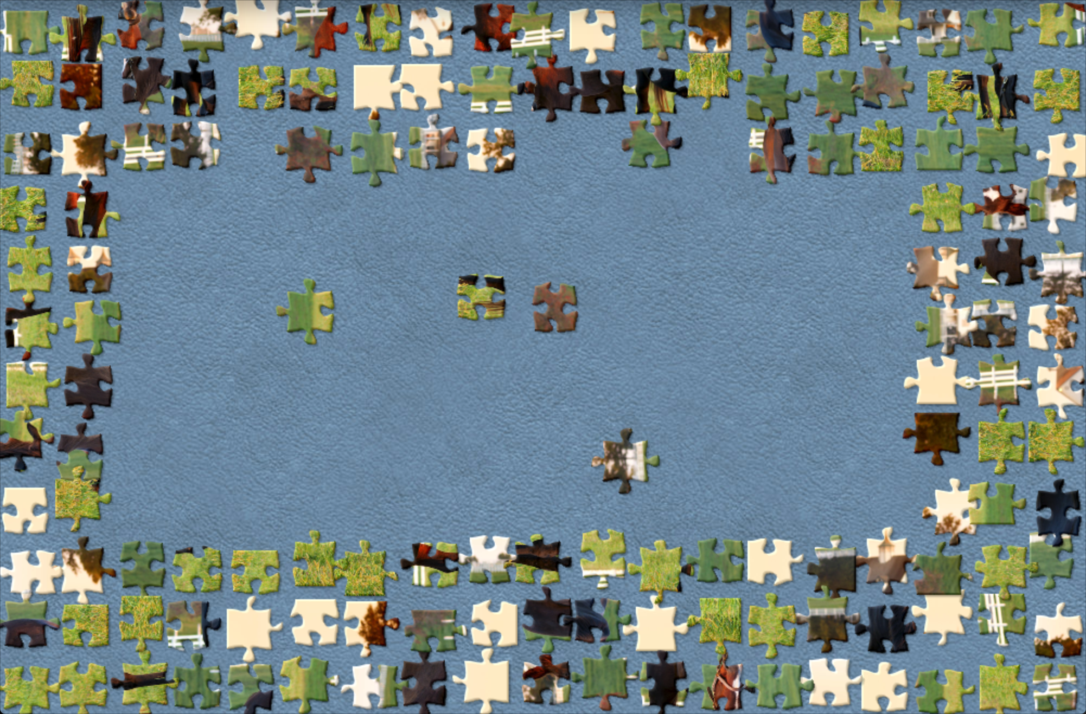
Jigsaw Puzzle Games
Notes:
Brightness
Rotation
problem Size

Slide 3
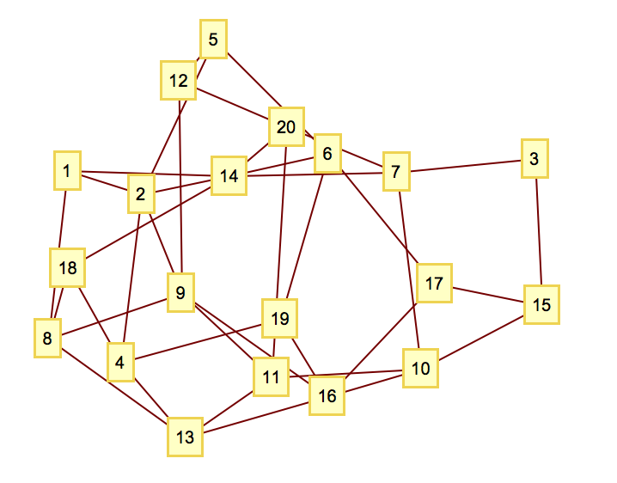
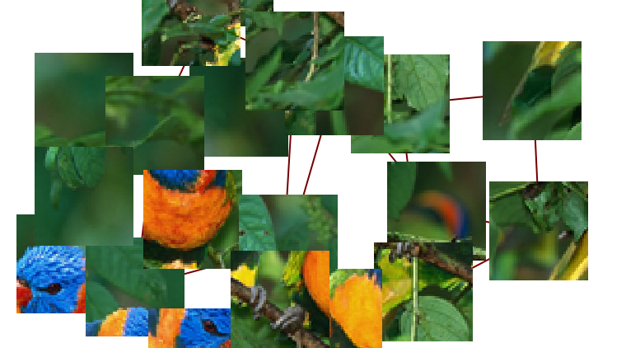
How did you solve the problem?

Slide 4
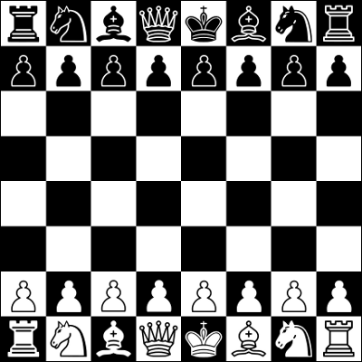





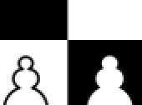

Good Feature of an Image
Flat Region
Edge
Corner
Feature

Slide 5
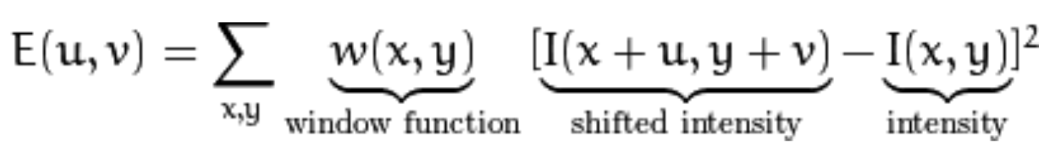
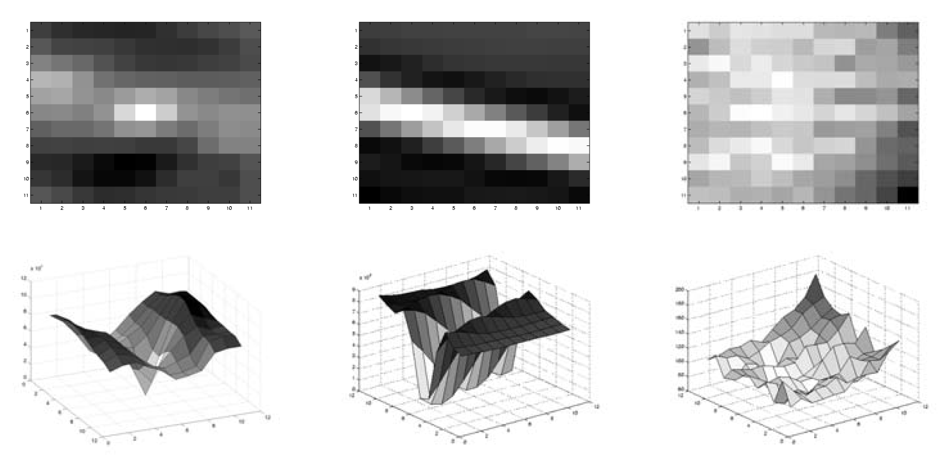
Harris Corner Detection
Window function:
Square or Gaussian
Sum of intensity change:
Rotation invariant
Complexity:
Point-point comparison
Need better targets

Slide 6
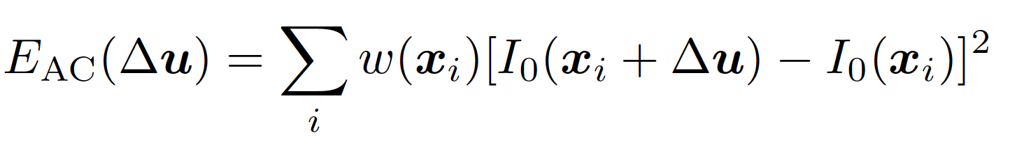
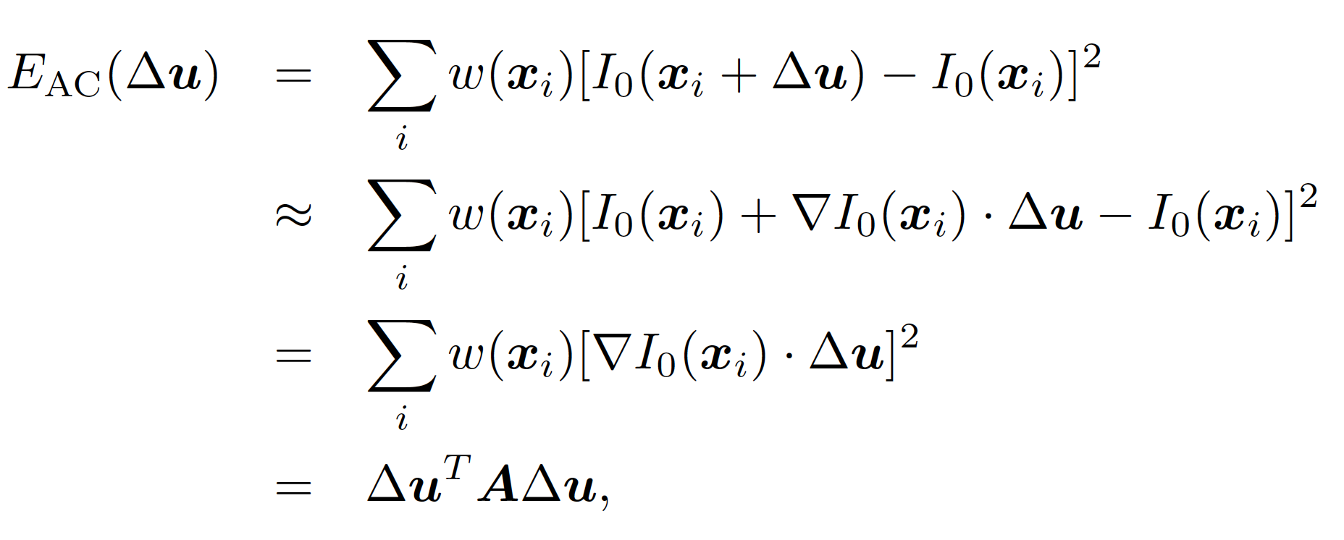
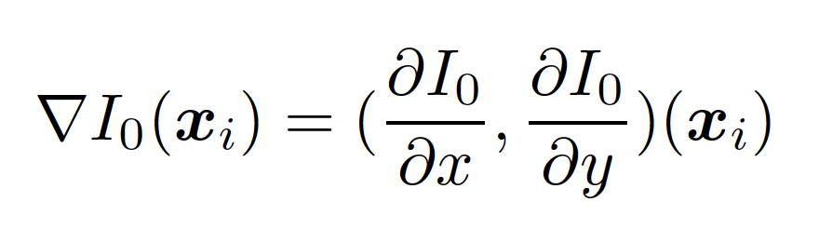
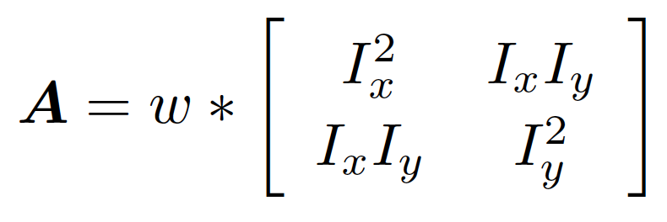
Minimization using Auto-Correction Matrix
Cite: Richard Szeliski

Slide 7
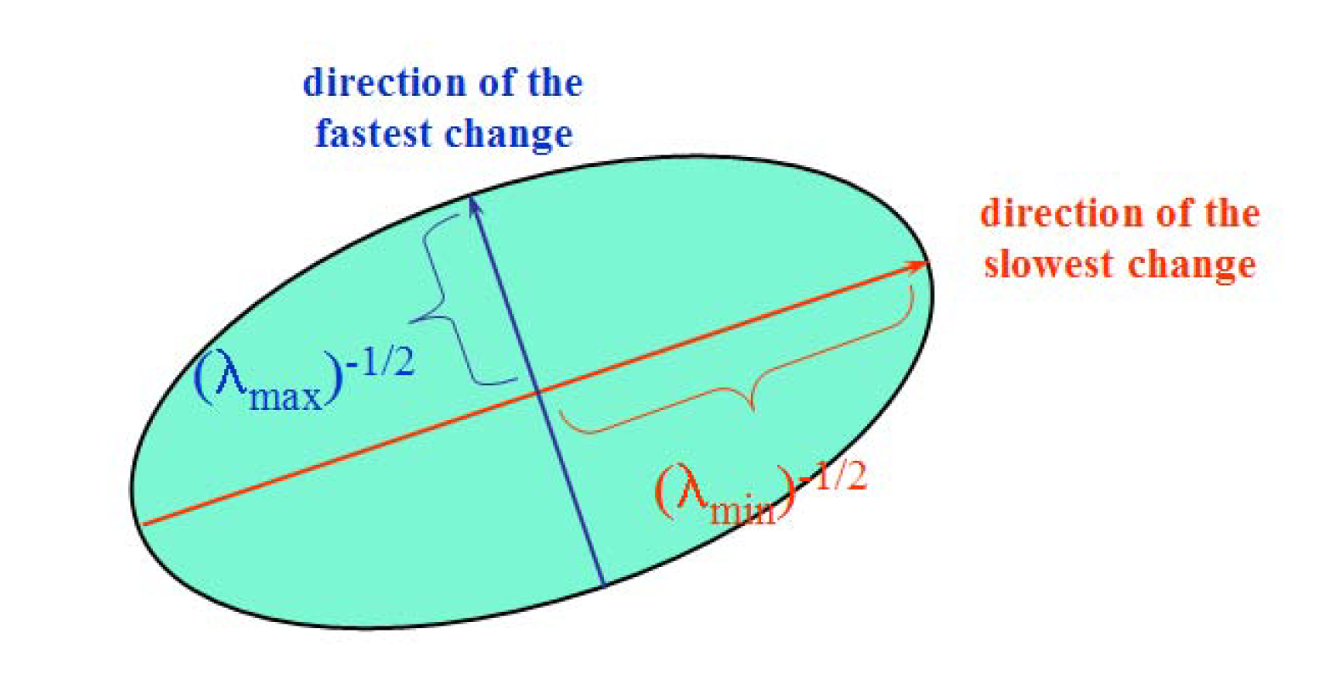
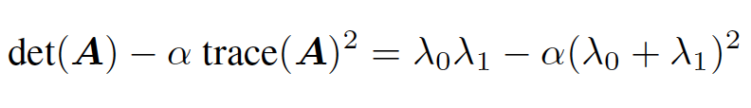
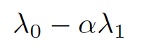
Eigenvalue Analysis
Scoring function
Harris
Triggs

Slide 8
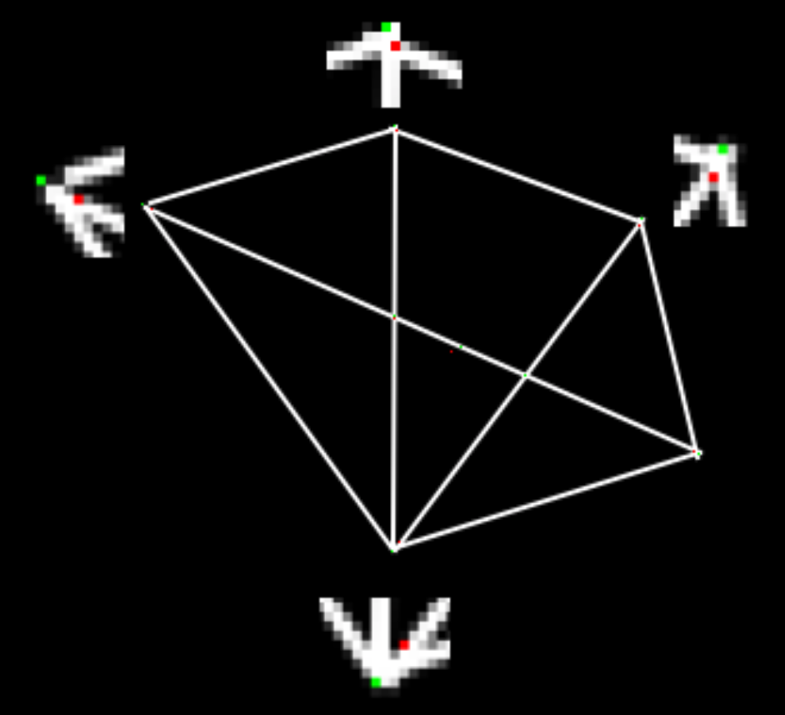
OpenCV Functions
cv2.cornerHarris(img, blockSize, ksize, k)
img - Input image, it should be grayscale and float32 type.
blockSize - It is the size of neighbourhood considered for corner detection
ksize - Aperture parameter of Sobel derivative used.
k - Harris detector free parameter in the equation.
cv2.cornerSubPix()
For sub-pixel accuracy

Slide 9
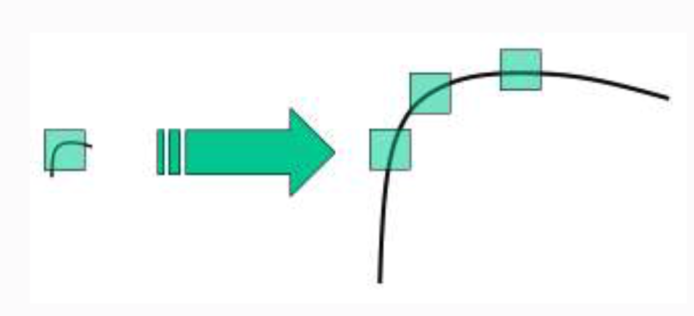
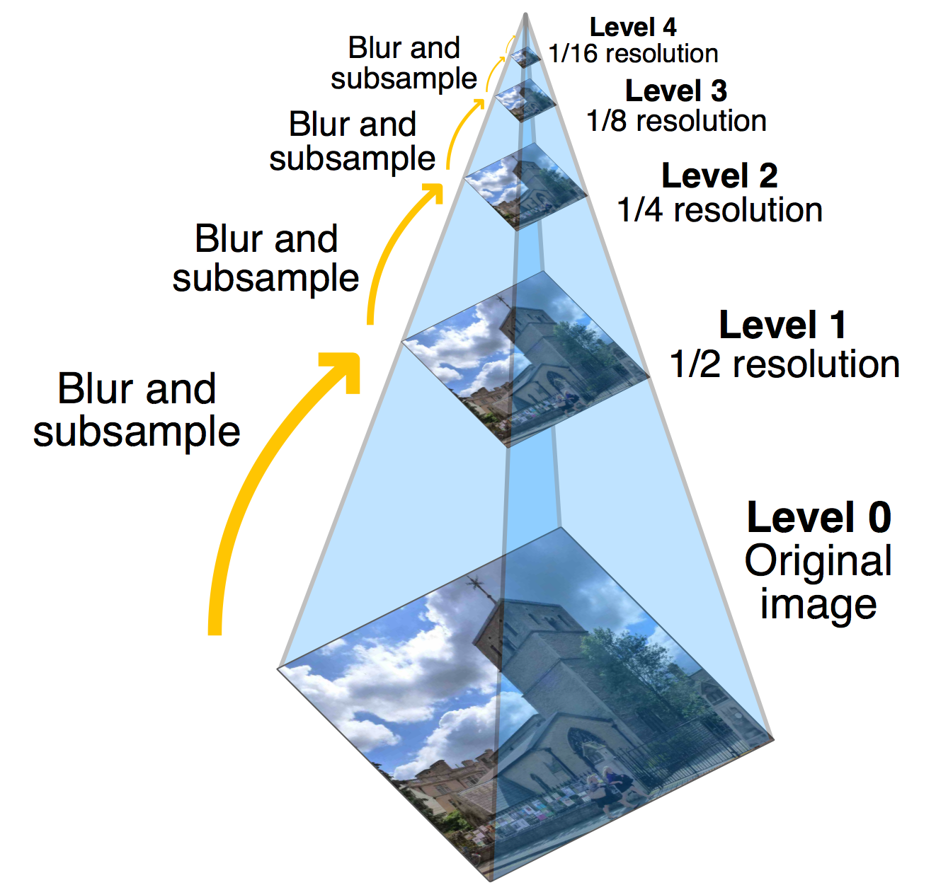
Scale-Invariant Feature Transform (SIFT)
Rotation Invariance
Scale Invariance
Lowe, David G. "Distinctive image features from scale-invariant keypoints.”

Slide 10
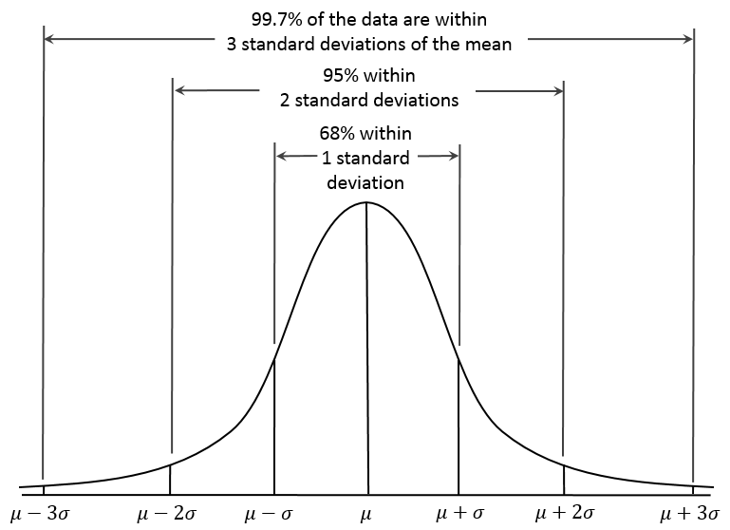
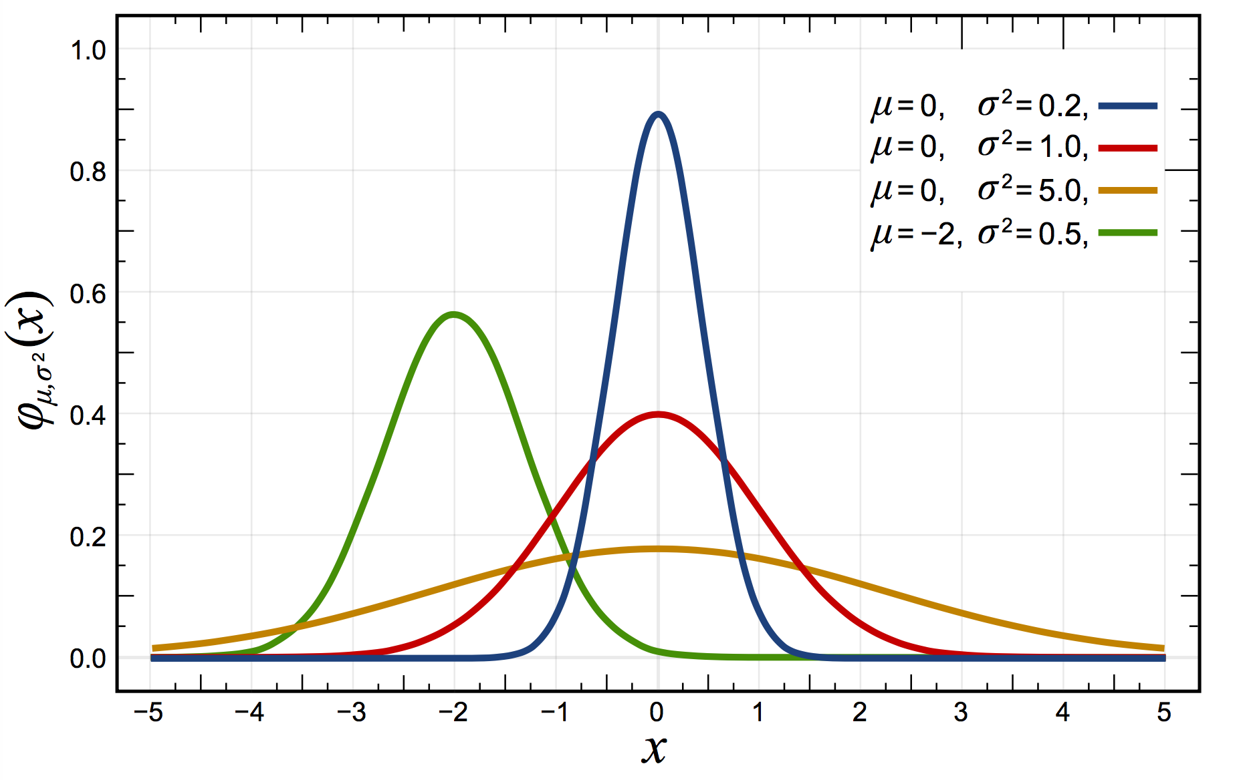
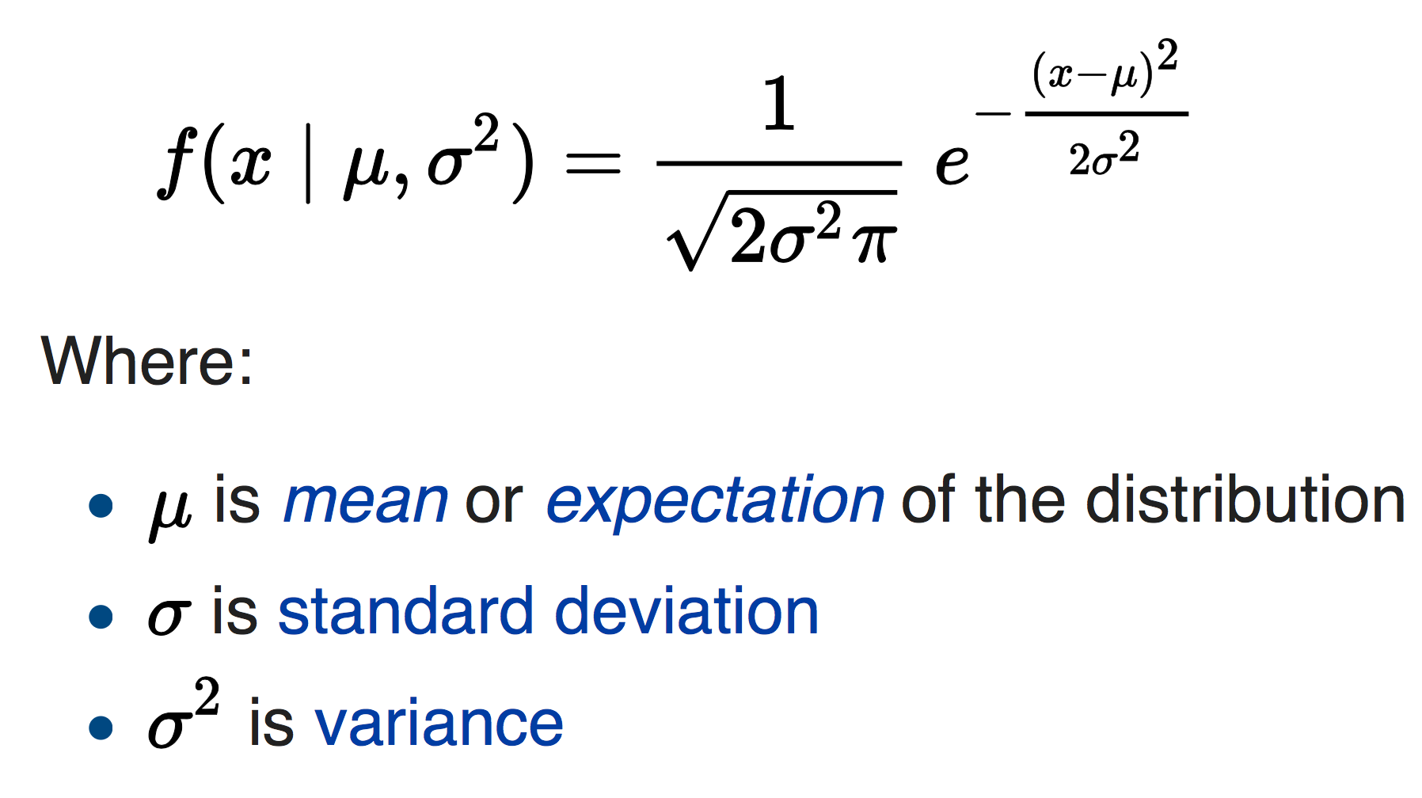
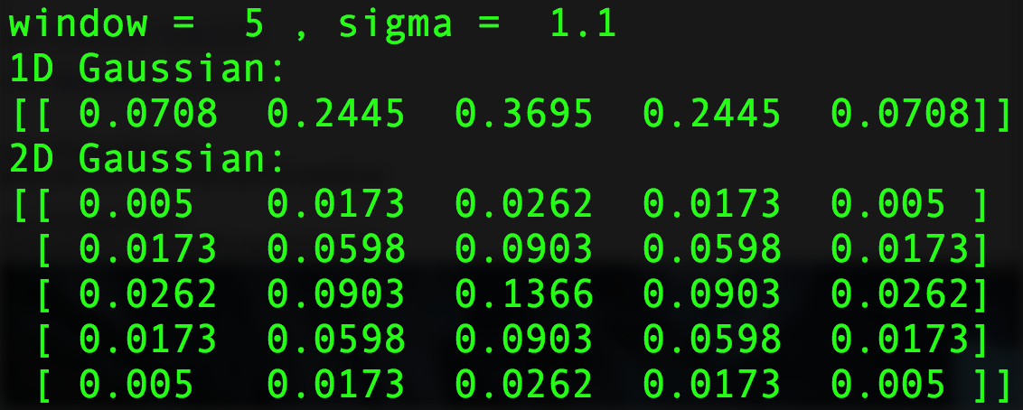
Gaussian Distribution
Wiki

Slide 11
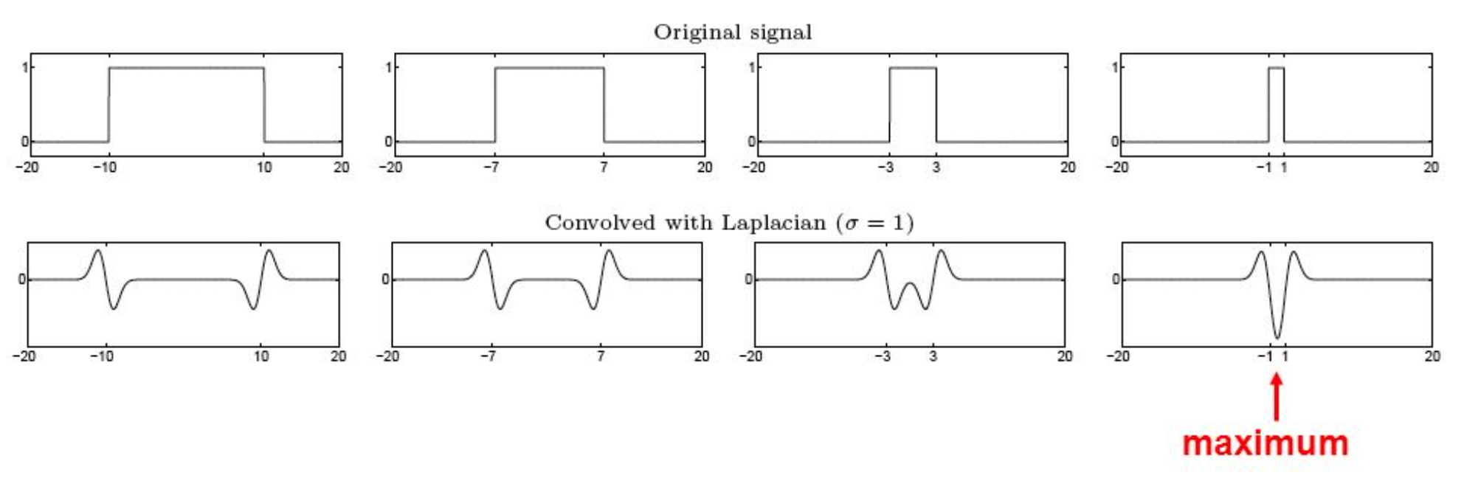
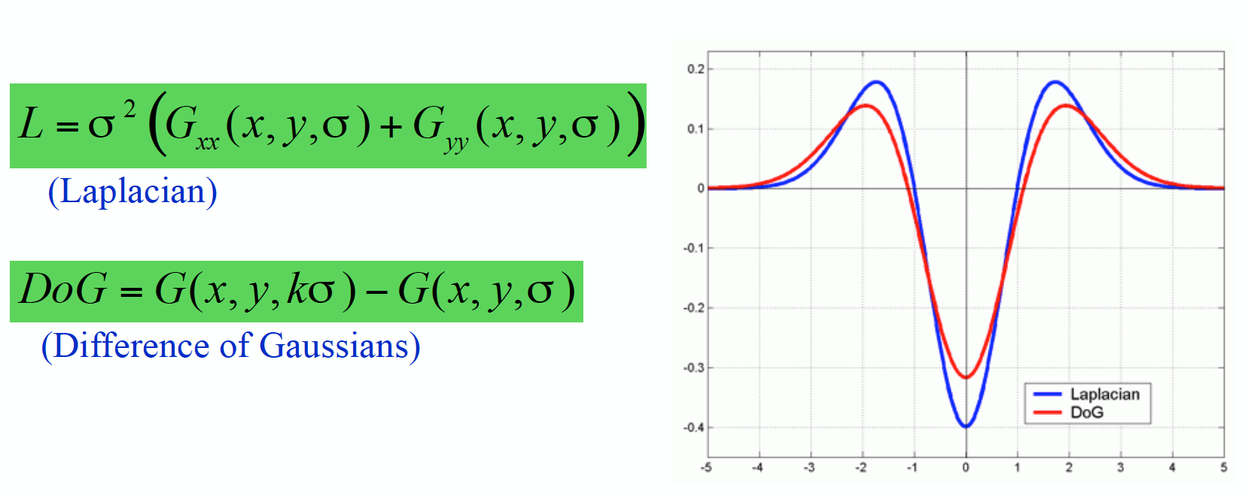
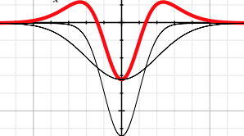
Difference of Gaussian ≈ Laplacian of Gaussian
S. Lazebnik

Slide 12
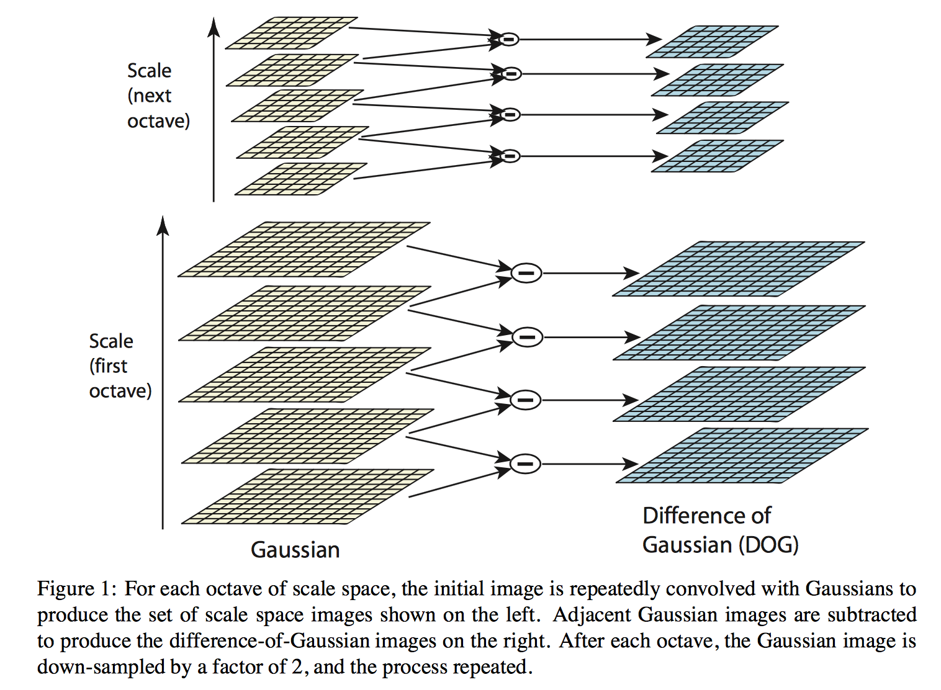
Scale Space
Lowe, David G.

Slide 13
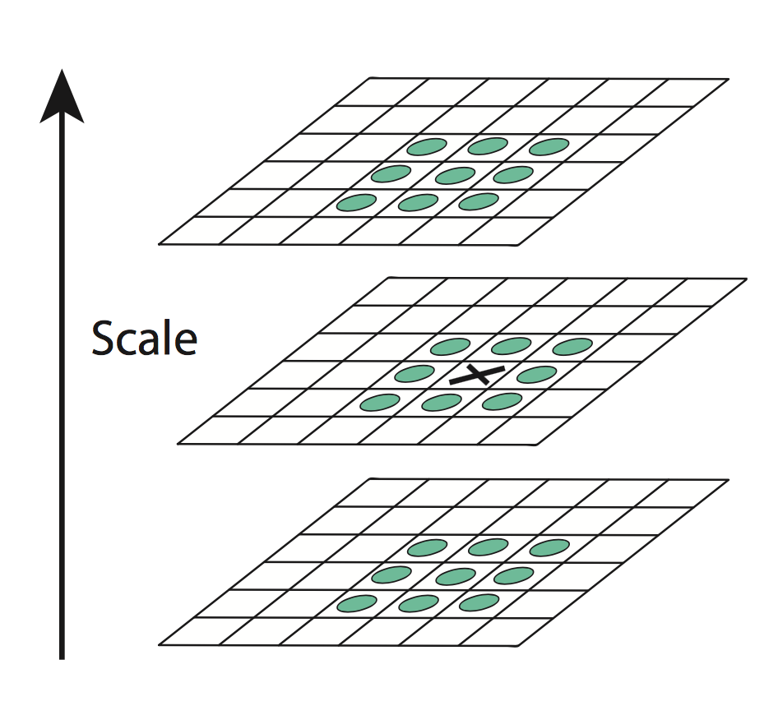
Keypoint Localization in Scale Space
Search for local extrema (Maxima and Minima) as good features
Discard weak or edge points
Lowe, David G.

Slide 14
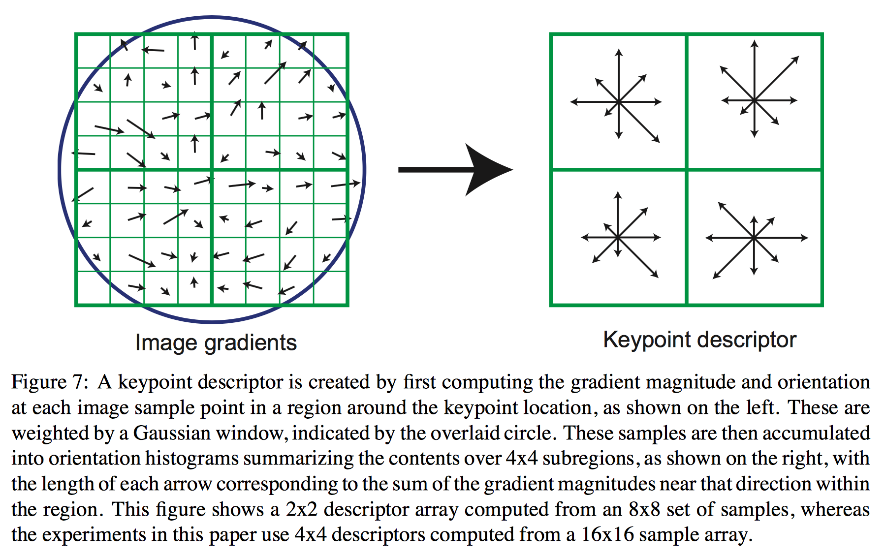
Keypoint Descriptor
Lowe, David G.

Slide 15
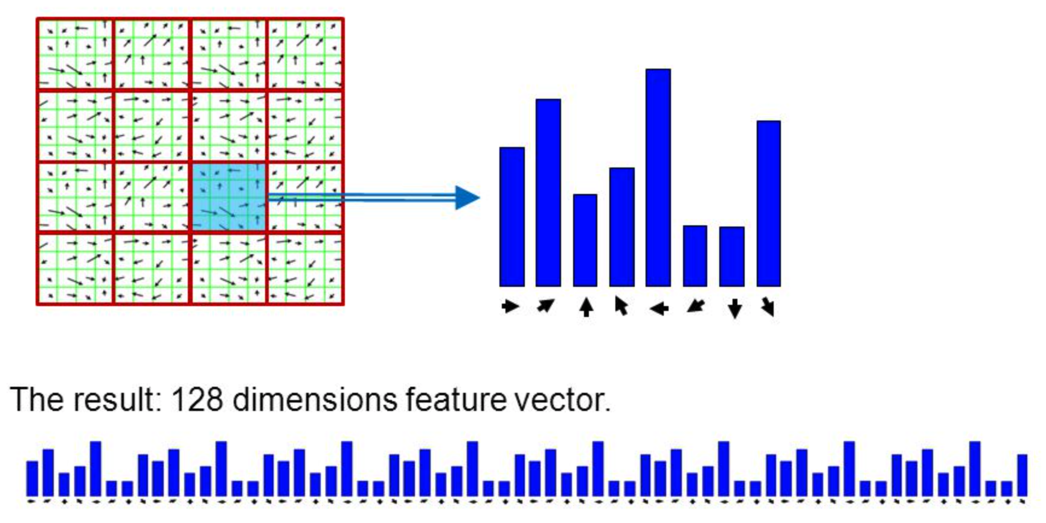
Generating Descriptor
Major
Direction

Slide 16
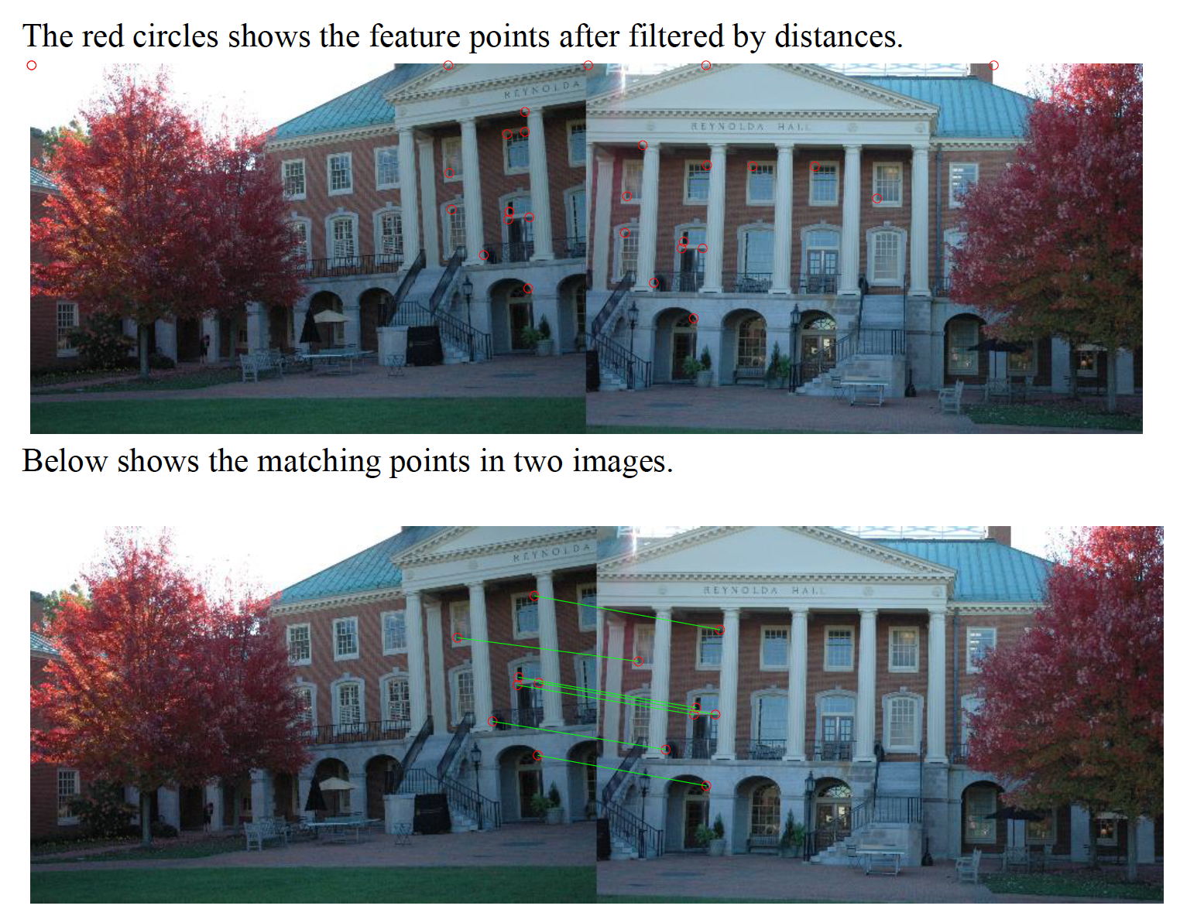
Image Stitching

Slide 17
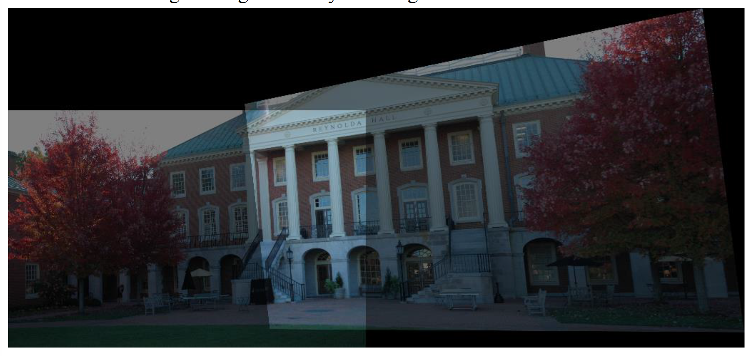
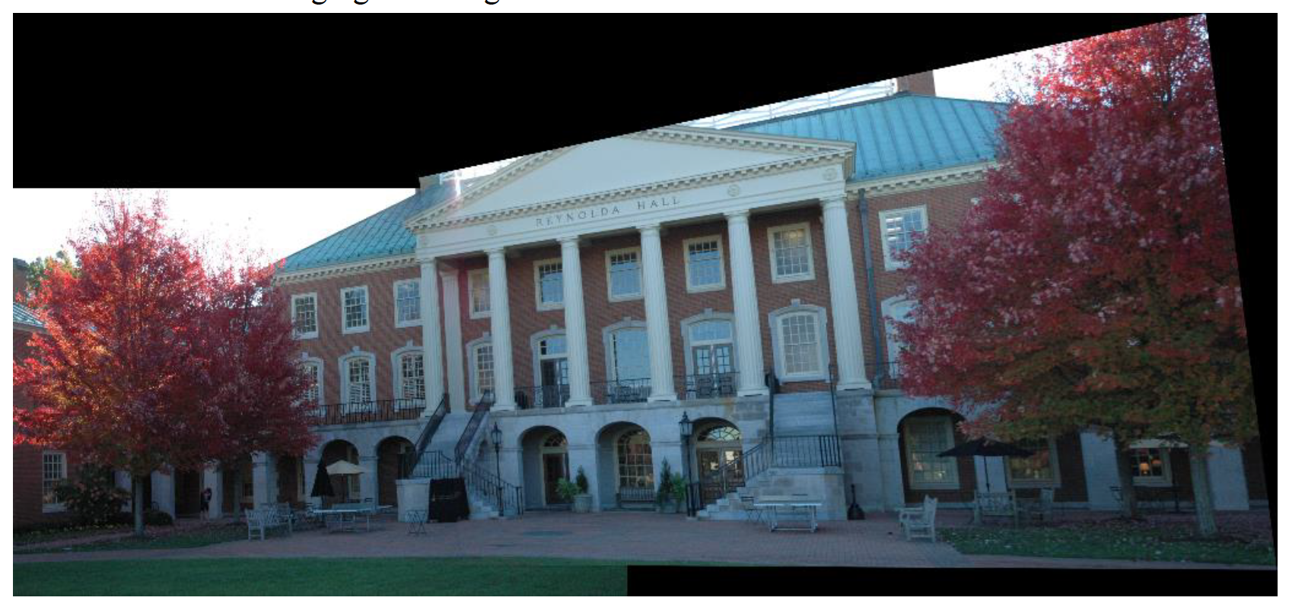
Image Stitching
Direct Stitching
g1+g2
Adjust Brightness
f(g1)+f(g2)

Slide 18
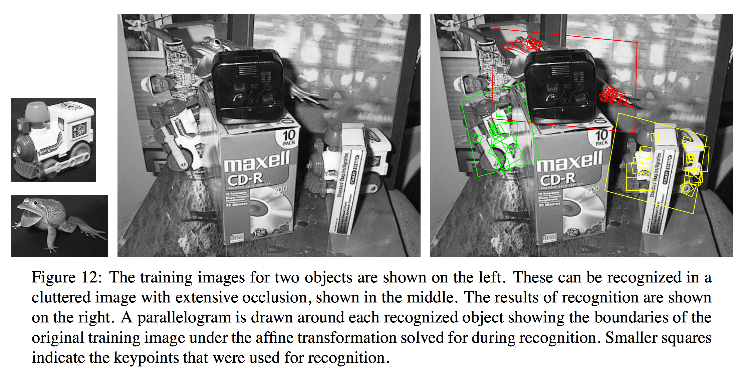
Keypoint Matching

Slide 19
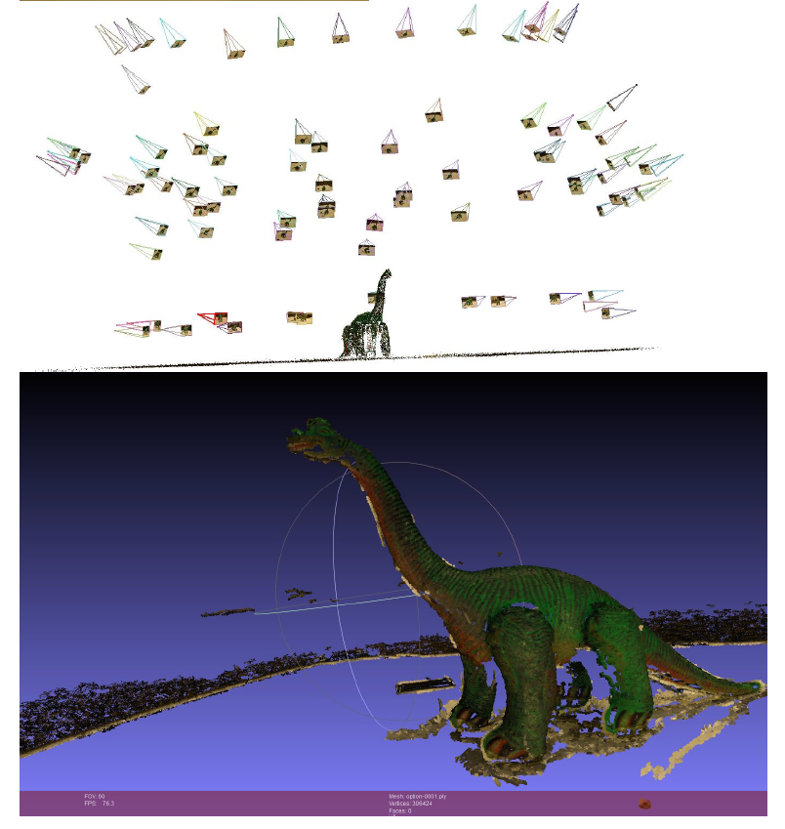
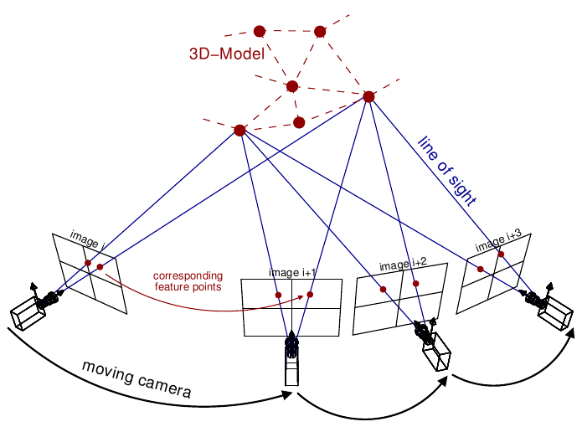
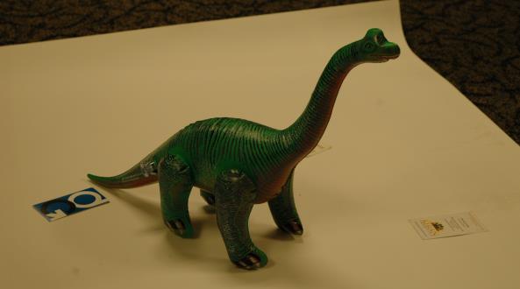
Structure from Motion

